Slide 1

MONASH INFORMATION TECHNOLOGY
FIT2100 Semester 2 2020
Lecture 7: Threads and Concurrency (Reading: Stallings, Chapter 4, 5)
WEEK 8

Slide 2
Lecture 7 (Part A): Learning Outcomes
Upon the completion of this lecture, you should be able to:
Understand the distinction between process and
thread
Describe the basic design issues for threads
Explain the difference between user-level threads and kernel-level threads
Discuss thread management in Unix/Linux
Reading from Stallings, Chapter 4 (4.1, 4.2, 4.6)
2

Slide 3
WHAT DO WE UNDERSTAND ABOUT PROCESSES?
A process ‘owns’ resources
Space in main memory, open files, I/O devices, etc.
An independent process image
One process is prevented from interfering with another process’s resources and image as allocated by the OS
Scheduling and execution
A process follows a ‘path’ of execution
Execution may be interleaved with other processes
Scheduled and dispatched by the OS.

Slide 4


The Concept of Threads
The unit of dispatching for execution is referred to as:
Thread or
Lightweight process
The unit of resource ownership is referred to as:
Process or task
e.g. Windows or
Unix
The entity that owns a resource is a process
4

Slide 5
The Concept of Threads
The unit of dispatching for execution is referred to as:
Thread or
Lightweight process
The unit of resource ownership is referred to as:
Process or task
Multi-threading:
The ability of an OS to support multiple concurrent paths of execution within a single process
1 process : multiple threads of execution.
4

Slide 6
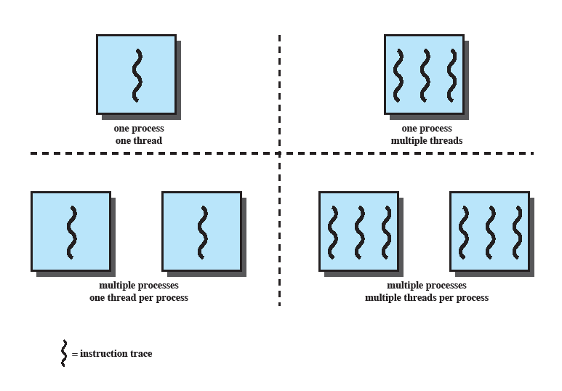
Single-Threaded Approaches
Left side of figure:
A single thread of execution per process.
The concept of a thread is not recognised — referred as a single- threaded approach.
Example: MS-DOS, Windows 3.1
4

Slide 7
Multi-Threaded Approaches
The right half of the figure depicts the multi- threaded approach.
One process with multiple threads.
Example: Windows, Linux.
4

Slide 8

The Concept of Processes (revisit)
The unit of resource allocation and a unit of protection.
A (virtual) address space that holds the process image.
Protected access to:
Processor(s)
Other processes
Files
I/O resources
Interprocess
communication
4

Slide 9
Threads within a Process
Different part of a program may do different things and they can be executed concurrently to improve response time (or completion time).
Example: one thread may do a processor-bound task like rendering an image, while another thread responds to user interaction in the same program.
If there is an interaction between different parts of the
programs — concurrency control need to be applied.
Example: accessing and modifying a common variable — mutual exclusion need to be satisfied.
4

Slide 10

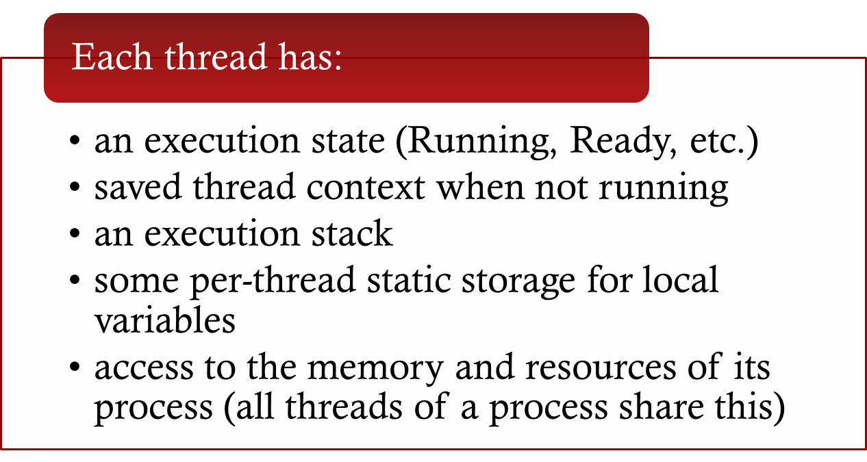
Attributes of a Thread

Slide 11
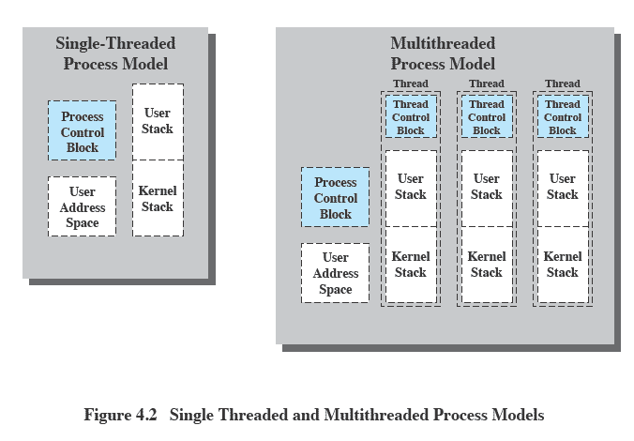
Threads vs. Processes
Single Threaded and Multithreaded Process Models

Slide 12
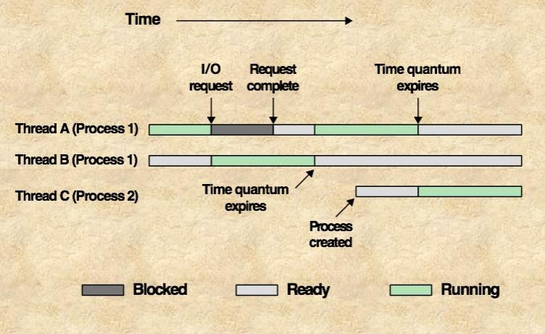
Thread States: Multi-threading on a Uniprocessor
e.g. One thread may run while another thread is blocked.

Slide 13
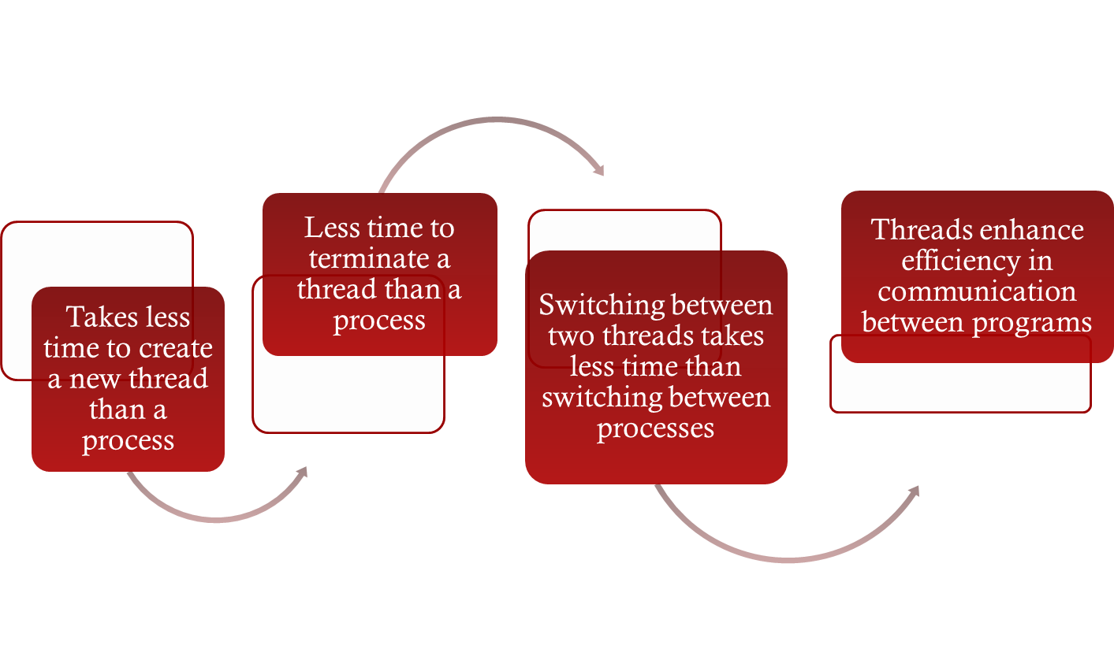
Benefits of Threads
Threads == ‘lightweight processes’

Slide 14
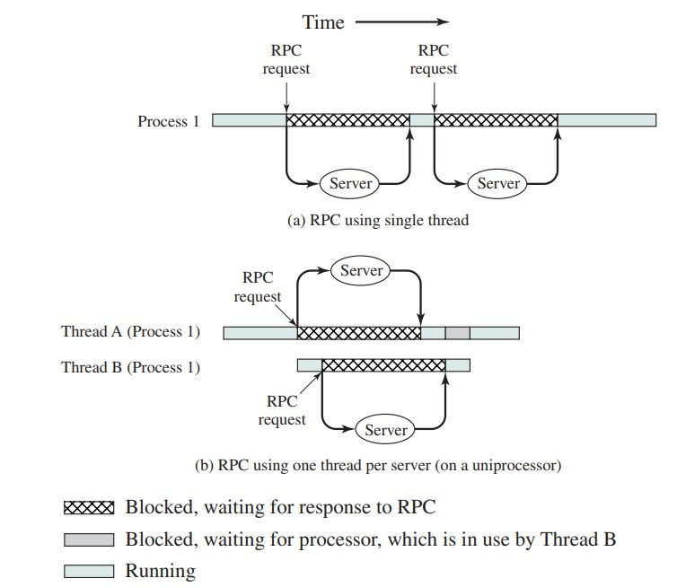
Benefits of Threads: Remote Procedure Call (RPC) Example

Slide 15
More on Threads
For an OS that supports threads, scheduling and dispatching is done on a thread basis.
Most of the state information dealing with execution is
maintained in thread-level data structures:
Suspending a process involves suspending all threads
of a process.
Termination of a process terminates all threads within the process.
All threads within a process share the same address space.
15

Slide 16
User-Level Thread (UTL) and Kernel-Level Thread (KLT)

Slide 17
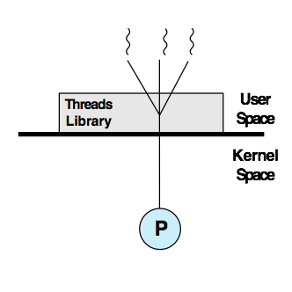
User-Level Threads (ULTs)
All thread management is done by the application.
The kernel is not aware of the existence of threads.
Any application can be programmed to be multi- threaded by using a threads library.
Even if OS does not support threads.
Pure user-level
17

Slide 18





ULTS: Advantages
Thread switching does not required kernel mode privileges
Scheduling can be
application specific
ULTs can run on any
Operating System
18

Slide 19
ULTS: Disadvantages
In a typical OS, many system calls are blocking.
When a ULT executes a system call, not only is that thread gets blocked, but all of the threads within the process are also blocked.
In a pure ULT strategy, a multi-threaded application cannot take the full advantage of multiprocessing.

Slide 20
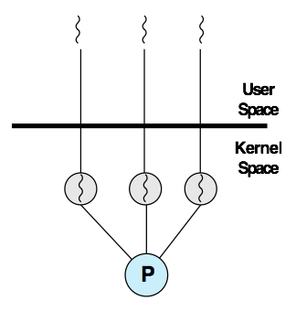
Kernel-Level Threads (ULTs)
Thread management is done by the kernel.
No thread management is done by the application — through API to the kernel thread facility.
Example: Windows, Linux
Pure kernel-level

Slide 21
KLTS: Advantages
The kernel can simultaneously schedule multiple threads from the same process on multiple processors.
If one thread in a process is blocked, the kernel can schedule another thread of the same process.
The kernel routines can also be multi-threaded.

Slide 22
KLTS: Disadvantages
The transfer of control from one thread to another thread within the same process requires a mode switch to the kernel.
Some overhead here.

Slide 23
How do Unix/Linux systems manage threads?

Slide 24
PTHREADS
Threads in Linux are known as pthreads. Managed
through a separate API.
The pthread library must be included and linked into the program in order to use threads.
#include <pthread.h>
Add –lpthread to the end of the gcc command to
link the program against the pthread library
pthread_create() – spawn a new thread
pthread_join() – wait for another thread to terminate

Slide 25
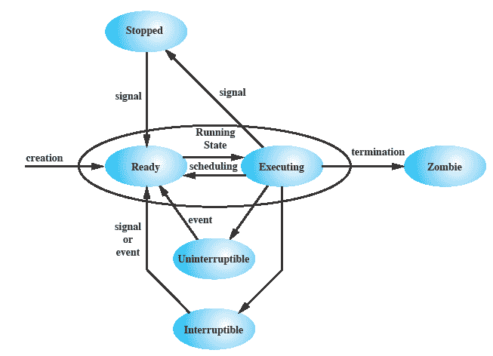
Linux: Process/Thread Model
25

Slide 26
Summary of Lecture 7 (Part A)
The concept of process is related to resource ownership.
The concept of thread is related to program execution.
In multi-threaded system, multiple concurrent threads may be defined with a single process.
Two types of threads: user-level and kernel level.
Reading from Stallings, Chapter 4: 4.1, 4.2 and 4.6
25

Slide 27
Lecture 7 (Part B): Learning Outcomes
Upon the completion of this lecture, you should be able to:
Discuss the basic concepts related to concurrency
Understand the concept of race condition
Describe the mutual exclusion requirements
25

Slide 28
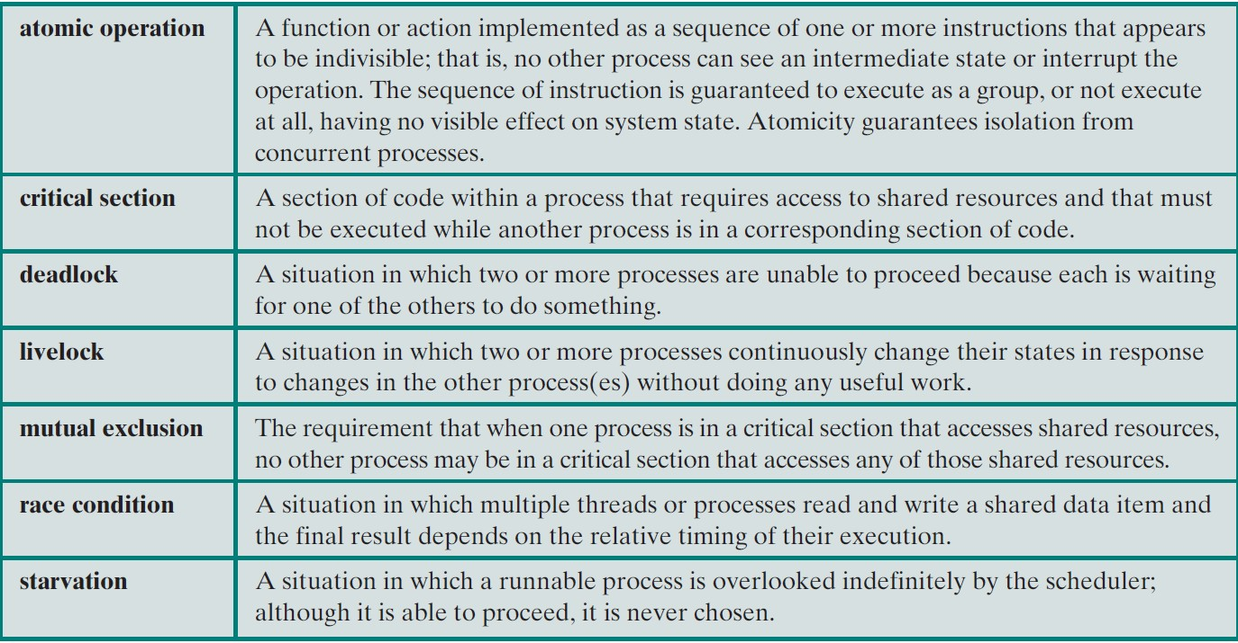
Concurrency: Terminology
25

Slide 29
What are the concurrency problems?

Slide 30
Concurrency: Problems
Concurrent access to shared data may result in data inconsistency — race condition
The problem exists in both multiprogramming on uni- and multi-processors
Maintaining data consistency requires mechanisms to ensure the orderly execution of cooperating processes.
Difficult to locate programming errors — results are not deterministic and reproducible
30

Slide 31
Race Condition
Occurs when multiple processes or threads read and write data items
Final result depends on the order of execution
"Loser" of the race is the process that updates last and will determine the final value of the variable
To prevent race conditions, concurrent processes must be synchronised
30

Slide 32
Concurrency Problem: Uniprocessor Multiprogramming
Consider the following
procedure:
void echo()
{
char_in = getchar(); char_out = char_in; putchar(char_out);
}
Read a character from the keyboard and store in char_in.
Transfer to char_out before being sent for display.
Consider two different applications — P1 and P2 — make a call to this procedure.
30

Slide 33
Concurrency Problem: Uniprocessor Multiprogramming
Consider the following
procedure:
void echo()
{
char_in = getchar(); char_out = char_in; putchar(char_out);
}
P1 invokes echo() and is interrupted immediately after getchar returns its value and stores it in char_in (e.g. x).
P2 is activated and invokes echo() and read a char (e.g. y) and runs to completion of the procedure.
When P1 resumes the value of x has been overwritten in char_in by process P2 and therefore its value x is lost.
30

Slide 34
Concurrency Problem: Uniprocessor Multiprogramming
Process P1:
char_in = getchar();
Process P2:
char_in = getchar(); char_out = char_in; putchar(char_out);
char_out = char_in; putchar(char_out);
\
TIME
30

Slide 35
Concurrency Problem: Uniprocessor Multiprogramming
Consider the following procedure:
void echo()
{
char_in = getchar(); char_out = char_in; putchar(char-out);
}
Assume only one process at a time to invoke and be in the echo procedure.
P1 invokes echo() and is interrupted immediately after getchar returns its value and stores it in char_in (x).
P2 is activated and invokes
echo().
But since P1 is still inside the procedure, and currently suspended — P2 is blocked from entering the procedure.
30

Slide 36
Concurrency Problem: Summary
P1 invokes the echo procedure and is interrupted immediately after getchar returns its value and stores it in char_in (e.g. x).
P2 is activated and invokes echo procedure and since the echo procedure is used by process P1, P2 is blocked from further execution.
At some later time, P1 is resumed and completes the execution of echo and the proper input character will be displayed.
When P1 exits echo, this removes the block on P2.
When P2 is later resumed, the echo procedure is successfully
invoked.
30

Slide 37
How about concurrency problems with multiprocessors?

Slide 38
Concurrency Problems: Multiprocessor Multiprogramming
Same problem arises even when the processes — P1 and P2 — runs on different processors accessing unprotected shared variables.
The solution outlined in the previous slides can work here.
Protecting and controlling access to shared resources are critical.

Slide 39
Question: Race Condition
Assume P1 and P2 share two variables a and b with initial values of a = 1 and b = 2
P1 executes the statement: a = a + b
P2 executes the statement: b = a + b
What values are a and b if P1 executes before P2?
What values are a and b if P2 executes before P1?

Slide 40
What are the control problems with concurrent processes?

Slide 41

Control Problems
Concurrent processes come into conflict when they are competing for the same system resource — I/O devices, memory, processor time, etc.
In the case of competing processes three control problems must be faced:
mutual exclusion
deadlock
starvation

Slide 42
Mutual Exclusion
Suppose n processes all competing to use some shared data.
Each process has a code segment — critical section — where the shared data is accessed or manipulated.
Ensure that when one process is executing in its critical section, no other process is allowed in its critical section.

Slide 43
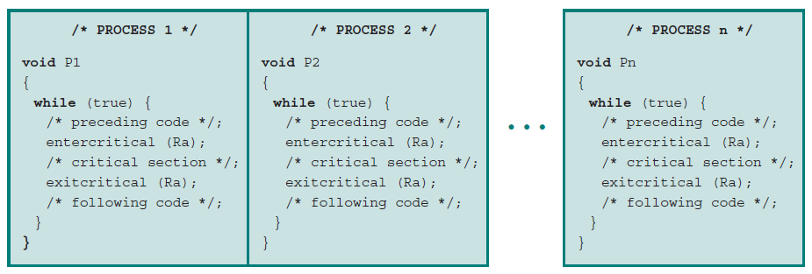
Mutual Exclusion: Example
To enforce mutual exclusion, two function are provided: entercritical and exitcritical with the resource as the argument.

Slide 44
Multiple Shared Data Resources
The same problem exists even when processes access more than one shared resource.
Processes must cooperate to ensure the shared data are properly managed.
Control mechanisms are needed to ensure the integrity of the shared data.

Slide 45
Multiple Shared Data Resources: Example
▪ P1  P2
a = a + 1 ; b = b + 1 ;
b = 2 * b ; a = 2 * a ;
Assuming that a = b at the beginning, and consider the following concurrent execution sequence:
a | = | a | + | 1 | ; | /* {P1} | */
b | = | 2 | * | b | ; | /* {P2} | */
b | = | b | + | 1 | ; | /* {P1} | */
a | = | 2 | * | a | ; | /* {P2} | */
At the end of this execution, the condition a = b
no longer holds!

Slide 46
Race Condition (revisit)
Process A
Process B
-------
-------
Critical Section
-------
-------
Ra (Shared)

Slide 47
Race Condition (revisit)
Process A
Ra
Process B
Ra
time
0
1
2
3
States
Ready
Running
Blocked

Slide 48
Solution: Mutual Exclusion
Process A
Ra
Blocked
Process B
Ra
Ra
time
0
1
2
3
States
Ready
Running
Blocked

Slide 49
Additional Control Problems
Deadlock: two or more processes are waiting indefinitely for the other processes to release the system resources.
Starvation: indefinite blocking of a process.

Slide 50
Mutual Exclusion: Requirements
Mutual Exclusion must be enforced.
A process that halts must do so without interfering with
other processes.
A process must not be denied access to a critical section when there is no other process is using the shared resources (being manipulated by the critical section code).
No assumptions are made about relative process speeds
or the number of processors.
A process remains inside its critical section for a finite time
only.
No deadlock or starvation.

Slide 51
Summary of Lecture 7 (Part B)
Concurrency is the fundamental concern in supporting multiprogramming, multiprocessing, and distributed processing.
Mutual exclusion is the condition where there is a set of concurrent processes — only one of which is able to access a given resource or perform a given function at any time.
Reading from Stallings, Chapter 5: 5.1
Next week: Concurrency mechanisms, deadlocks and starvation.

